Slide 1
Bulma Framework
By: Henry, Noah, and Stephen

Slide 2
What is Bulma framework?
Bulma is a modern open-source framework for developing web applications using CSS only, JavaScript is not required. It is developed based on flexbox.
A flexbox is a layout used to define various columns and rows that makes the grid-like structure. It is used to design a flexible responsive layout structure without using float or positioning.
Bulma framework is easy to use and strong documentation is provided.
Bulma was published in the year 2016 and distributed under MIT license.

Slide 3
Features and advantages:
Easy to use and simple to learn: Bulma’s straightforward and intuitive syntax makes it easy for developers to grasp and start using the framework quickly. Its class naming conventions are simple and self-explanatory, making it accessible for beginners.
Open source and support major browsers
Mobile-first design
Responsive design: Bulma offers built-in responsiveness, ensuring that websites built with the framework adapt seamlessly across different devices and screen sizes. It provides responsive grids, columns, and components out of the box.
Customization Options: Bulma allows developers to customize their designs by leveraging Sass variables. This enables easy colour customization, typography adjustments, and other visual modifications to match the project’s branding and style.
It supports modular design
JavaScript is not required, Everything is coded in CSS and Customization is very easy

Slide 4
Disadvantages
Limited Component Library: While Bulma provides a decent set of components, it may not offer the same level of breadth and depth as frameworks like Bootstrap or Material-UI. Developers may need to create custom components or rely on additional libraries to meet specific design requirements.
Although Bulma has an active community, it may not have as extensive a support network as frameworks like Bootstrap or Material-UI. Finding pre-built solutions, themes, or plugins may require more effort.
the framework is in development, the final version is in processing

Slide 5
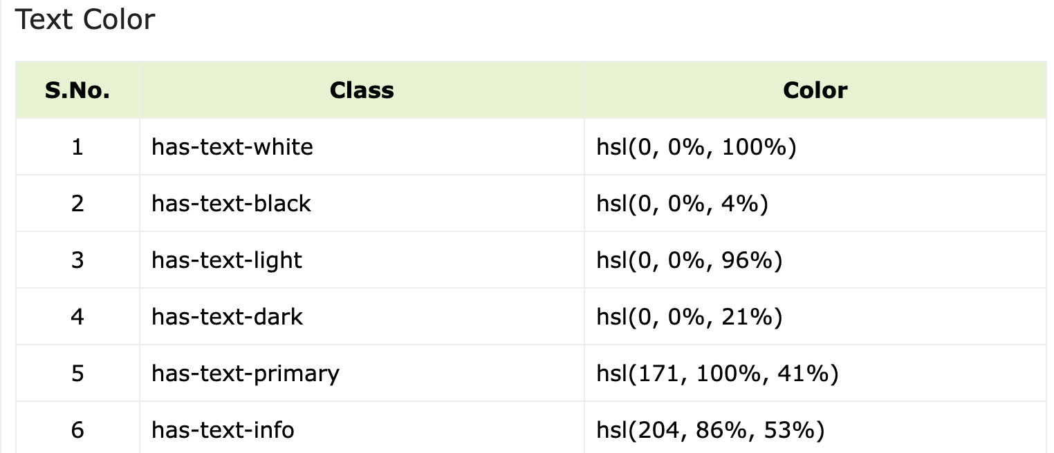
Bulma - Colour and Typography Helpers
You can use the colour helpers for changing colour of the text or background. You can create alternative styles for the elements by using modifier classes and use the responsive classes to alter styles. The modifier classes start with is-ClassName or has-ClassName and using these classes, you can provide different types of styles for the elements.

Slide 6
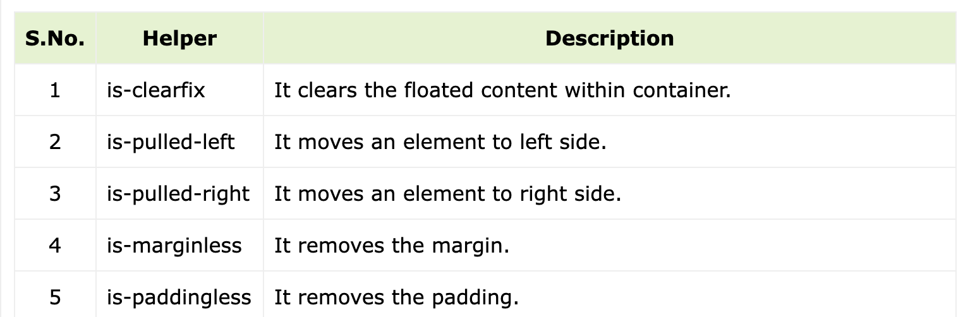
Helpers: You can use the below helper classes to alter styles of elements

Slide 7
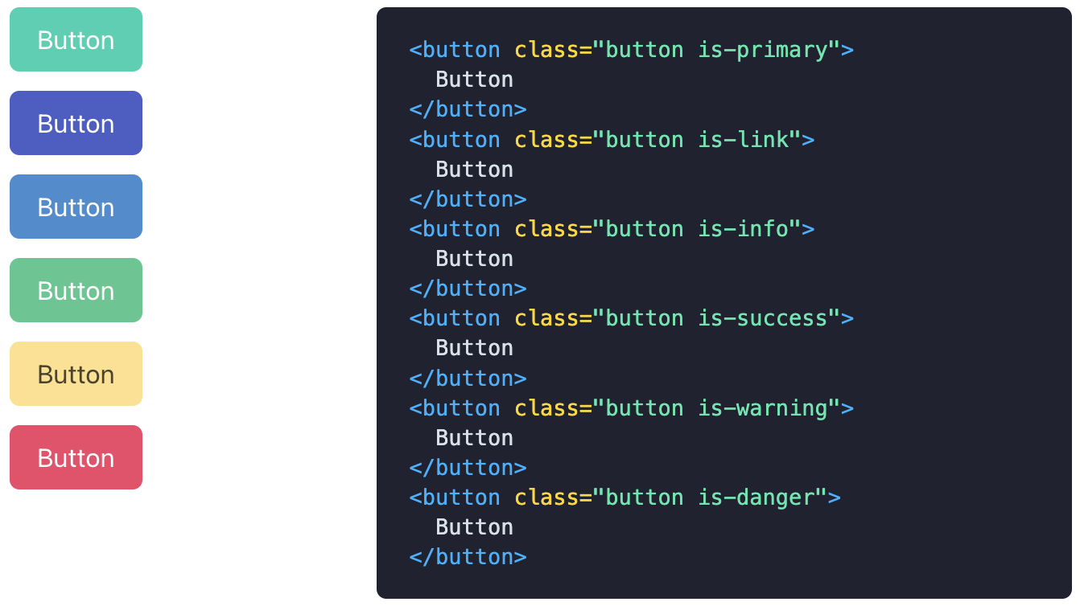
Sample Bulma CODE FOR CREATING A BUTTON WITH DIFFERENT COLOURS

Slide 8
Examples of Initializing Variables:
Initial variables: where you define variables by literal value, like:
colors: $blue: hsl(229, 53%, 53%)
font sizes: $size-1: 3rem
dimensions: $gap: 32px
other values: $easing: ease-out or $radius-large: 6px

Slide 9

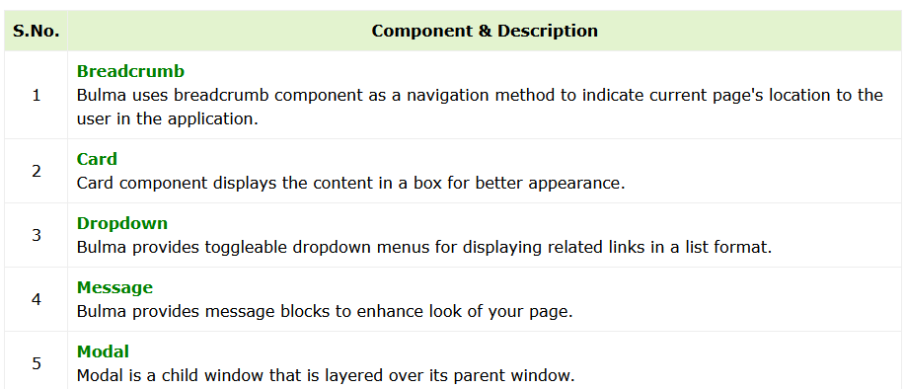
Balma Components:
Bulma comes with pre-styled components, which provides dropdowns, modal, pagination, navbar, tabs etc to make user experience easily in the page.
The following table lists down variations of components which you can use to utilize the Bulma CSS −

Slide 10
Alternative Frameworks:
Foundation
Bootstrap
Tailwind
Material- Design
React

Slide 11
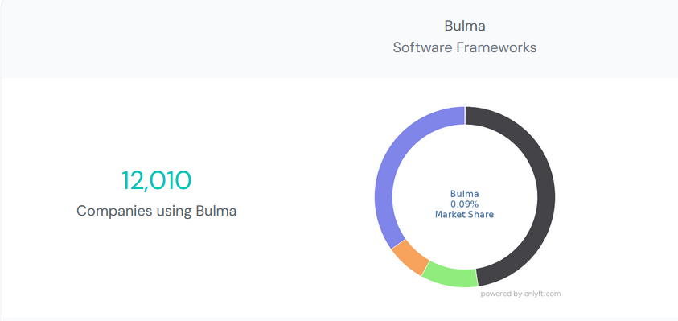
Number of companies that uses Bulma
ifnovative.com
cltienemobile.com
puzzalarium.com
cyberdefendersprogram.com
crystalicecompany.com

Slide 12
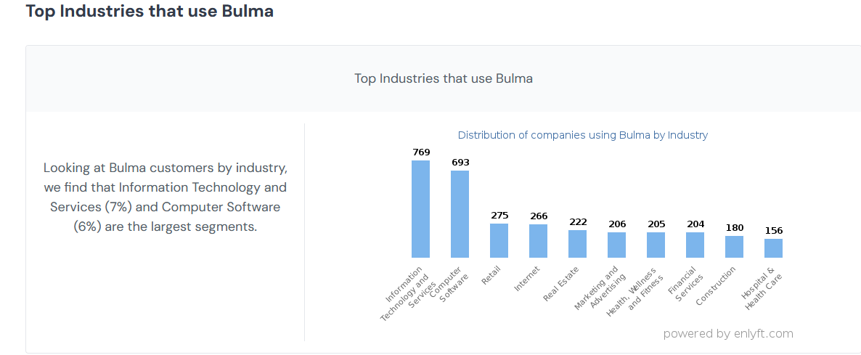
Top Industries that Use Bulma

Slide 13
Reference:
https://www.tutorialspoint.com/bulma/bulma_elements_content.htm
https://pnjiru.medium.com/tailwind-css-vs-eecfd72f389
https://enlyft.com/tech/products/bulma
https://stackshare.io/bulma/alternatives

